Slide 1
CHAPTER-2
EMBEDDED SYSTEM ARCHITECTURE
Learning objectives:
To explain hardware architecture of embedded system
Understand the ARM Cortex M0+ Hardware Overview
Explain about serial and parallel communication
Describe ATmega32 microcontroller Architecture
Discuss about Interface peripherals, port, Interrupts, ISR and Timers
Faculty of Computing and Informatics, JIT, Jimma University, Jimma, Oromia, Ethiopia Presented by Dr. Faiz Akram

Slide 2
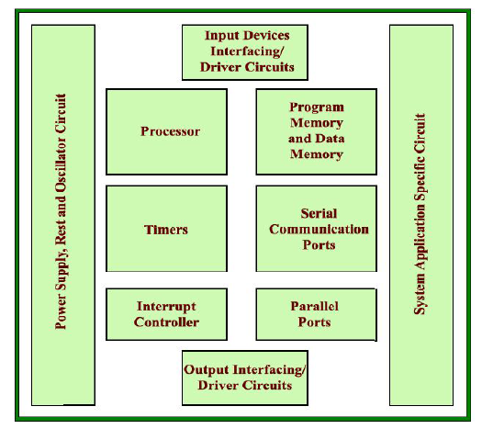
EMBEDDED SYSEM HARDWARE
Faculty of Computing and Informatics, JIT, Jimma University, Jimma, Oromia, Ethiopia Presented by Dr. Faiz Akram

Slide 3
Hardware components of an embedded system
Hardware components of an embedded system:
The Embedded system hardware includes elements like user interface, Input/Output interfaces, display and memory, etc.
Generally, an embedded system comprises power supply, processor, memory, timers, serial communication ports and system application specific circuits.
Faculty of Computing and Informatics, JIT, Jimma University, Jimma, Oromia, Ethiopia Presented by Dr. Faiz Akram

Slide 4
ARCHITECTURE OF AN EMBEDDED SYSTEM
Typical embedded system mainly has two parts i.e., embedded hardware and embedded software.
Embedded hardware are based around microprocessor and microcontrollers, also include memory, bus, Input/Output, Controller, where as embedded software includes embedded operating systems, different applications and device drivers. Basically these two types of architecture i.e., Havard architecture and Von Neumann architecture are used in embedded systems.
The main part of Embedded System hardware architecture:
Architecture of the Embedded System includes Sensor, Analog to Digital Converter, Memory, Processor, Digital to Analog Converter, and Actuators etc.
The figure on next slide illustrates the overview of basic architecture of embedded systems:
Faculty of Computing and Informatics, JIT, Jimma University, Jimma, Oromia, Ethiopia Presented by Dr. Faiz Akram

Slide 5
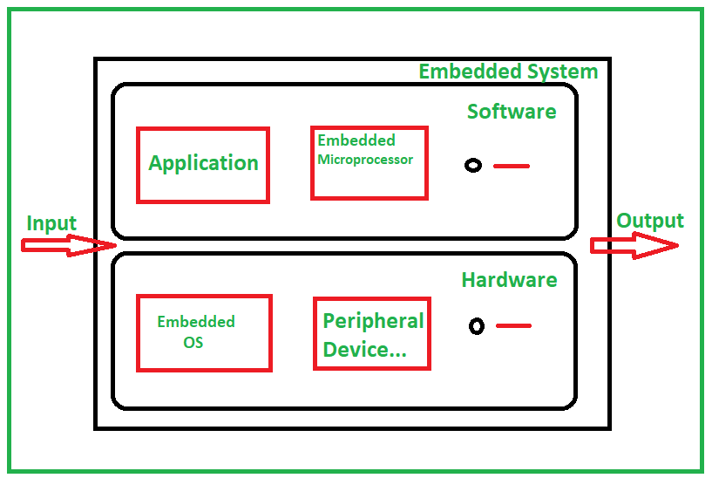
ARCHITECTURE OF AN EMBEDDED SYSTEM
Fig: Basic architecture of embedded systems
Faculty of Computing and Informatics, JIT, Jimma University, Jimma, Oromia, Ethiopia Presented by Dr. Faiz Akram

Slide 6
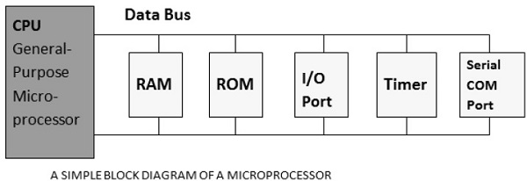
Basic Structure of an Embedded System
Microprocessor:
A microprocessor is a single VLSI chip having a CPU.
Microcontroller:
A microcontroller is a single-chip VLSI unit (also called microcomputer) which, although having limited computational capabilities.
CPU | RAM | ROM
I/O Port | Timer | Serial COM Port
Microcontrollers are particularly used in embedded systems for real-time control applications with on-chip program memory and devices.
Faculty of Computing and Informatics, JIT, Jimma University, Jimma, Oromia, Ethiopia Presented by Dr. Faiz Akram

Slide 7
Embedded Systems - Architecture Types
Hardware architecture for embedded system:
Basically these two types of architecture i.e., Havard architecture and Von Neumann architecture are used in embedded systems. Architecture of the Embedded System includes Sensor, Analog to Digital Converter, Memory, Processor, Digital to Analog Converter, and Actuators etc.
The 8051 microcontrollers work with 8-bit data bus. So they can support external data memory up to 64K and external program memory of 64k at best. Collectively, 8051 microcontrollers can address 128k of external memory.
When data and code lie in different memory blocks, then the architecture is referred as Harvard architecture. In case data and code lie in the same memory block, then the architecture is referred as Von Neumann architecture.
Von Neumann architecture :
In a normal computer that follows Von Neumann architecture, instructions and data both are stored in the same memory. So same buses are used to fetch instructions and data. This means the CPU cannot do both things together (read the instruction and read/write data).
Faculty of Computing and Informatics, JIT, Jimma University, Jimma, Oromia, Ethiopia Presented by Dr. Faiz Akram

Slide 8
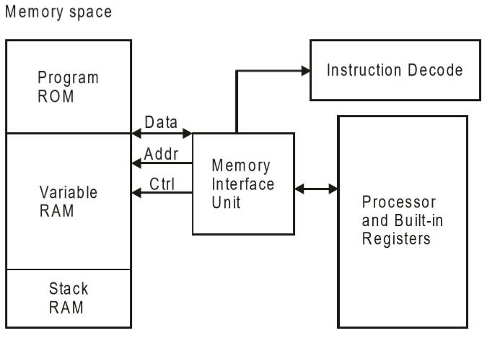
Embedded Systems - Architecture Types....contd
(Von Neumann Architecture)
Von Neumann Architecture:
The Von Neumann architecture was first proposed by a computer scientist John von Neumann. In this architecture, one data path or bus exists for both instruction and data. As a result, the CPU does one operation at a time. It either fetches an instruction from memory, or performs read/write operation on data. So an instruction fetch and a data operation cannot occur simultaneously, sharing a common bus.
Von-Neumann architecture supports simple hardware. It allows the use of a single, sequential memory. Today's processing speeds vastly outpace memory access times, and we employ a very fast but small amount of memory (cache) local to the processor.
Faculty of Computing and Informatics, JIT, Jimma University, Jimma, Oromia, Ethiopia Presented by Dr. Faiz Akram

Slide 9
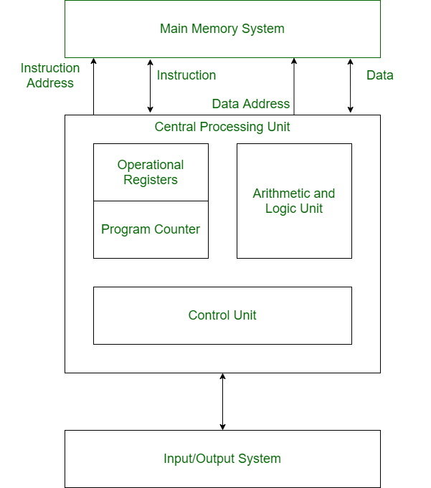
Embedded Systems - Architecture Types....contd
Structure of Harvard Architecture
Harvard Architecture is the computer architecture that contains separate storage and separate buses (signal path) for instruction and data. It was basically developed to overcome the bottleneck of Von Neumann Architecture. The main advantage of having separate buses for instruction and data is that the CPU can access instructions and read/write data at the same time.
Faculty of Computing and Informatics, JIT, Jimma University, Jimma, Oromia, Ethiopia Presented by Dr. Faiz Akram

Slide 10
Embedded Systems - Architecture Types....contd
Structure of Harvard Architecture
Buses:
Buses are used as signal pathways. In Harvard architecture, there are separate buses for both instruction and data. Types of Buses:
Data Bus(DB: It carries data among the main memory system, processor, and I/O devices.
Data Address Bus(DAB): It carries the address of data from the processor to the main memory system.
Instruction Bus(IB): It carries instructions among the main memory system, processor, and I/O devices.
Instruction Address Bus(IAB): It carries the address of instructions from the processor to the main memory system.
Operational Registers(OR):
There are different types of registers involved in it which are used for storing addresses of different types of instructions.
For example, the Memory Address Register(MAR) and Memory Data Register(MDR) are operational registers.
Program Counter(PC):
It has the location of the next instruction to be executed. The program counter(PC) then passes this next address to the memory address register(MAR).
Faculty of Computing and Informatics, JIT, Jimma University, Jimma, Oromia, Ethiopia Presented by Dr. Faiz Akram

Slide 11
Embedded Systems - Architecture Types
(Structure of Harvard Architecture)
Arithmetic and Logic Unit(ALU)
The arithmetic logic unit is that part of the CPU that operates all the calculations needed. It performs addition, subtraction, comparison, logical Operations, bit Shifting Operations, and various arithmetic operations.
Control Unit(CU)
The Control Unit is the part of the CPU that operates all processor control signals. It controls the input and output devices and also controls the movement of instructions and data within the system.
Input/Output System
Input devices are used to read data into main memory with the help of CPU input instruction. The information from a computer as output is given through Output devices. The computer gives the results of computation with the help of output devices.
Advantage of Harvard Architecture:
Harvard architecture has two separate buses for instruction and data. Hence, the CPU can access instructions and read/write data at the same time. This is the major advantage of Harvard architecture.
In practice, Modified Harvard Architecture is used where we have two separate caches (data and instruction). This is common and used in X86 and ARM processors.
Faculty of Computing and Informatics, JIT, Jimma University, Jimma, Oromia, Ethiopia Presented by Dr. Faiz Akram

Slide 12
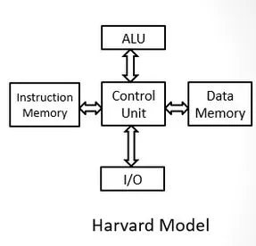
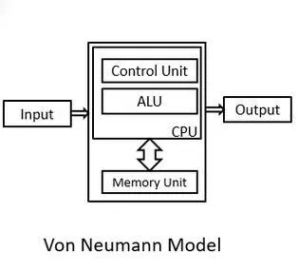
Von-Neumann Architecture vs Harvard Architecture
Faculty of Computing and Informatics, JIT, Jimma University, Jimma, Oromia, Ethiopia Presented by Dr. Faiz Akram

Slide 13
Von-Neumann Architecture vs Harvard Architecture(Check)
The following points distinguish the Von Neumann Architecture from the Harvard Architecture.
Von-Neumann Architecture | Harvard Architecture
It is ancient computer architecture based on stored program computer concept. | It is modern computer architecture based on Harvard Mark I relay based model.
Single memory to be shared by both code and data. | Separate memories for code and data.
Processor needs to fetch code in a separate clock cycle and data in another clock cycle. So it requires two clock cycles. | Single clock cycle is sufficient, as separate buses are used to access code and data.
Higher speed, thus less time consuming. | Slower in speed, thus more time-consuming.
Simple in design. | Complex in design.
There is common bus for data and instruction transfer. | Separate buses are used for transferring data and instruction.
It is used in personal computers and small computers. | It is used in micro controllers and signal processing.
Faculty of Computing and Informatics, JIT, Jimma University, Jimma, Oromia, Ethiopia Presented by Dr. Faiz Akram

Slide 14
Peripheral Devices in Embedded Systems
Embedded systems communicate with the outside world via their peripherals, such as following;
Serial Communication Interfaces (SCI) like RS-232, RS-422, RS-485, etc.
Synchronous Serial Communication Interface (SSCI)like I2C, SPI, SSC,
and ESSI
Universal Serial Bus (USB)
Multi Media Cards (SD Cards, Compact Flash, etc.)
Networks like Ethernet, LonWorks, etc.
Fieldbuses like CAN-Bus, LIN-Bus, PROFIBUS, etc.
Imers like PLL(s), Capture/Compare and Time Processing Units.
Discrete IO aka General Purpose Input/Output (GPIO)
Analog to Digital/Digital to Analog (ADC/DAC)
Debugging like JTAG(mechanism for debugging embedded systems),
ISP, ICSP, BDM Port, BITP, and DP9 ports
Faculty of Computing and Informatics, JIT, Jimma University, Jimma, Oromia, Ethiopia Presented by Dr. Faiz Akram

Slide 15
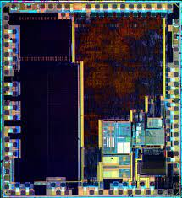
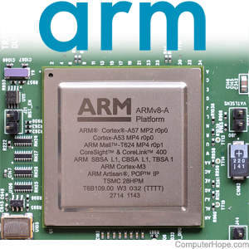
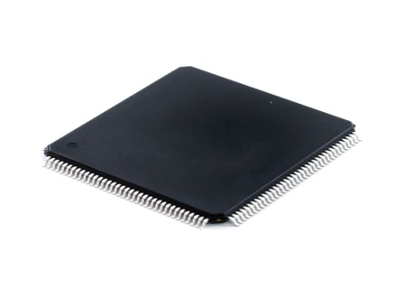
ARM Cortex-M0+
The ARM Cortex-M is a group of 32-bit RISC ARM processor cores licensed by Arm Holdings. These cores are optimized for low-cost and energy-efficient integrated circuits, which have been embedded in tens of billions of consumer devices.
ARM based Microcontrollers (MCU) contain a 32-bit wide data bus. An ARM MCU is developed by ARM Holdings that contains an ARM processor core developed based on Advanced RISC Machine (ARM) architecture with32-bit RISC (reduced instruction set computer) instruction set in it.
Faculty of Computing and Informatics, JIT, Jimma University, Jimma, Oromia, Ethiopia Presented by Dr. Faiz Akram

Slide 16
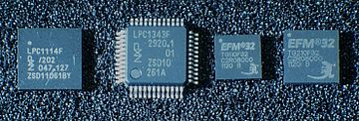
ARM Cortex-M0+ ....contd
The ARM Cortex-M0+ processor is the most energy efficient
ARM processor available for embedded applications with design
constraints.
ARM-An ARM processor is one of a family of CPU based on the
RISC(reduced instruction set computer) architecture developed
by advanced RISC machine(ARM). ARM processor are
extensively used in consumer electronic devices.
Such as smart phone, tables, multimedia players.
32-bit
Year | Core
2004 | Cortex-M3
2007 | Cortex-M1
2009 | Cortex-M0
2010 | Cortex-M4
2012 | Cortex-M0+
2014 | Cortex-M7
2016 | Cortex-M23
2016 | Cortex-M33
2018 | Cortex-M35P
2020 | Cortex-M55
ARM Cortex-M0 and Cortex-M3 microcontroller ICs from NXP and Silicon Labs
Faculty of Computing and Informatics, JIT, Jimma University, Jimma, Oromia, Ethiopia Presented by Dr. Faiz Akram

Slide 17
ARM Cortex M0+ Hardware Overview
Features:
2-stage pipeline enabling faster branch instruction execution with fewer
clock cycles and minimizes power consumption
World leading energy efficiency, maximizing battery life and enabling
smaller, lighter applications
A micro trace buffer provides a simple, low-cost debugging solution that
allows faster bug identification and correction without the need for
additional I/O resources
Faculty of Computing and Informatics, JIT, Jimma University, Jimma, Oromia, Ethiopia Presented by Dr. Faiz Akram

Slide 18
ARM Cortex M0+ Hardware Overview
Connectivity and Versatility:
Each application is different and has its specific needs. The Cortex-M0+ processor offers a wide choice of options, like sharing the Memory Protection unit and the re-locatable vector-table with the Cortex-M3 and Cortex-M4 processors.
Specifications:
High performance 32-bit CPU
2.42 CoreMark/MHz – 0.93 DMIPS/MHz
Low latency 2-stage pipeline
Integrated WFI and WFE sleep state and sleep signal support
Optional Micro Trace Buffer
Few Applications:
Building automation system
Lighting control system
Data acquisition system
Motion control
IoT and Sensor networks.
Faculty of Computing and Informatics, JIT, Jimma University, Jimma, Oromia, Ethiopia Presented by Dr. Faiz Akram

Slide 19
CISC and RISC
CISC is a Complex Instruction Set Computer. It is a computer that can address a large number of instructions.
In the early 1980s, computer designers recommended that computers should use fewer instructions with simple constructs so that they can be executed much faster within the CPU without having to use memory. Such computers are classified as Reduced Instruction Set Computer or RISC.
The following points differentiate a CISC from a RISC-
CISC | RISC
Larger set of instructions. Easy to program | Smaller set of Instructions. Difficult to program.
Simpler design of compiler, considering larger set of instructions. | Complex design of compiler.
Faculty of Computing and Informatics, JIT, Jimma University, Jimma, Oromia, Ethiopia Presented by Dr. Faiz Akram

Slide 20
CISC and RISC....contd
(Differentiate a CISC from a RISC)
Many addressing modes causing complex instruction formats. | Few addressing modes, fix instruction format.
Higher clock cycles per second. | Low clock cycle per second.
Emphasis is on hardware. | Emphasis is on software.
Control unit implements large instruction set using micro-program unit. | Each instruction is to be executed by hardware.
Slower execution, as instructions are to be read from memory and decoded by the decoder unit. | Faster execution, as each instruction is to be executed by hardware.
Pipelining is not possible. | Pipelining of instructions is possible, considering single clock cycle.
Pipelining is the process of accumulating instruction from the processor through a pipeline.
Faculty of Computing and Informatics, JIT, Jimma University, Jimma, Oromia, Ethiopia Presented by Dr. Faiz Akram

Slide 21
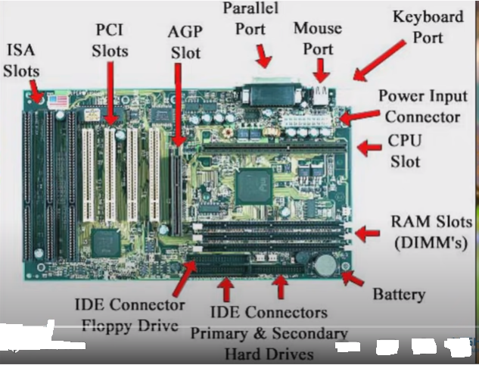
Microprocessor(µP)
Faculty of Computing and Informatics, JIT, Jimma University, Jimma, Oromia, Ethiopia Presented by Dr. Faiz Akram

Slide 22
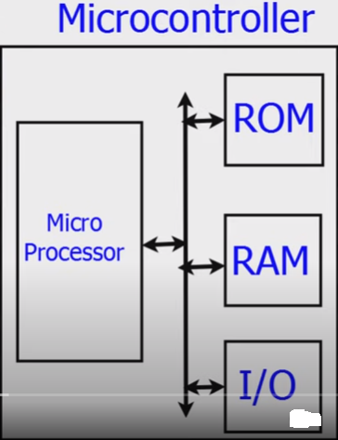
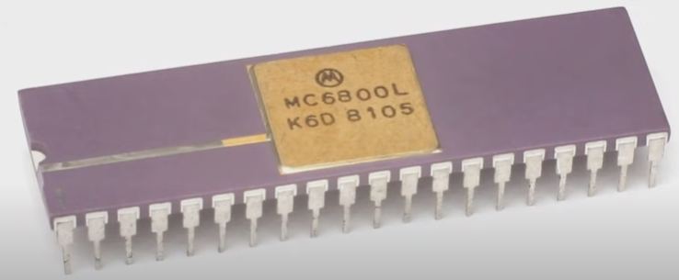
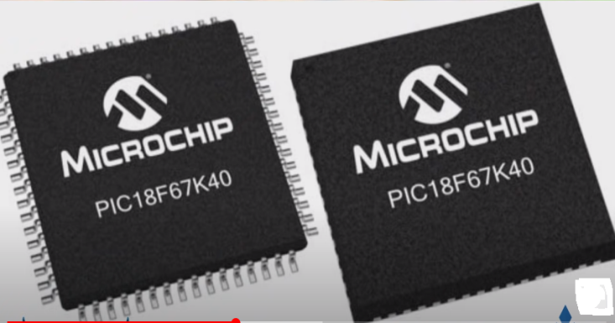
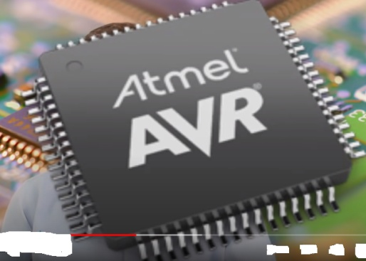
Micro-controller(µC)
Microcontroller concept came in 1970.Motorola is the first company who launched microcontroller and more than 200 company making it at present time. And more than 100,000 variety of microcontroller is available in the market.
Faculty of Computing and Informatics, JIT, Jimma University, Jimma, Oromia, Ethiopia Presented by Dr. Faiz Akram

Slide 23
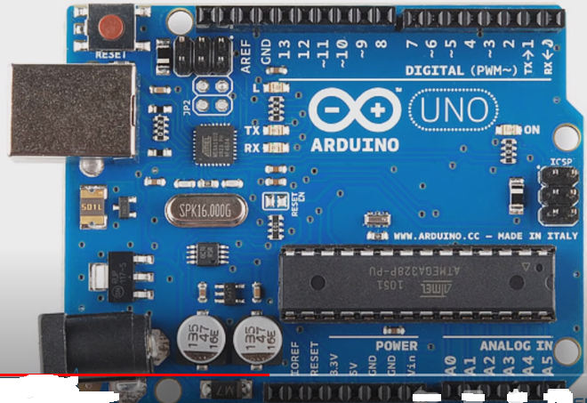
Micro-controller(µC)
Embedded c+electronics=Microcontoller
Faculty of Computing and Informatics, JIT, Jimma University, Jimma, Oromia, Ethiopia Presented by Dr. Faiz Akram

Slide 24
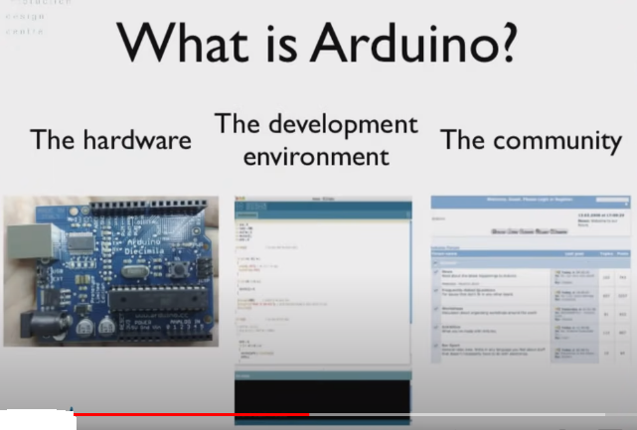
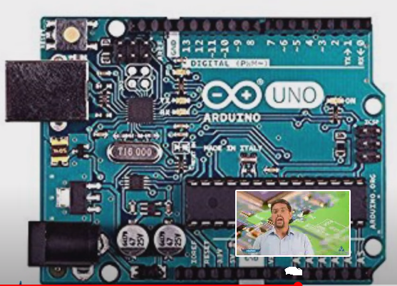
Micro-controller(µC)
Arduino is open source and more than 200,000,00 peoples are connected with it and more than 100,000 project is available and developed own language is known as arduino language .Arduino UNO is the famous board.
Faculty of Computing and Informatics, JIT, Jimma University, Jimma, Oromia, Ethiopia Presented by Dr. Faiz Akram

Slide 25
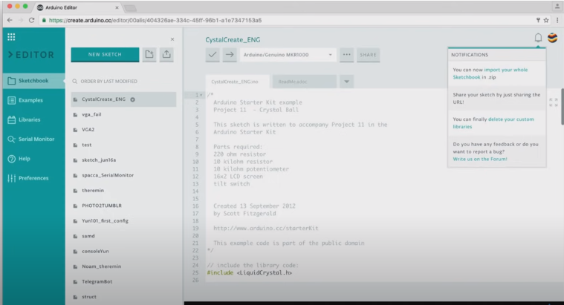
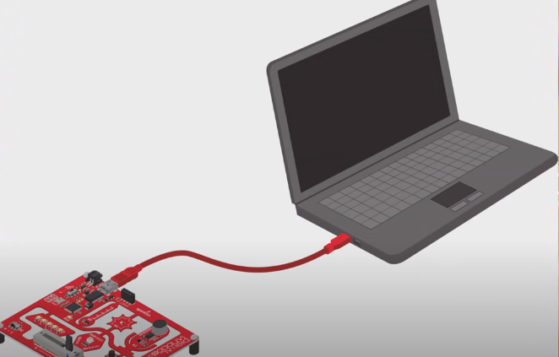
Micro-controller(µC)
Faculty of Computing and Informatics, JIT, Jimma University, Jimma, Oromia, Ethiopia Presented by Dr. Faiz Akram

Slide 26

Micro-controller(µC)
100,000,00 project available on arduino playground
Faculty of Computing and Informatics, JIT, Jimma University, Jimma, Oromia, Ethiopia Presented by Dr. Faiz Akram

Slide 27
Different between AVR Micro-controller(µC) and ARM Micro-controller(µC)
S.No | AVR | ARM
1. | AVR micro controller refers to Advanced Virtual RISC (AVR). | ARM micro controller refers to Advanced RISC Micro-controller (ARM).
2. | It has bus width of 8 bit or 32 bit. | It has bus width of 32 bit and also available in 64 bit.
3. | It uses ART, USART, SPI, I2C communication protocol. | It uses SPI, CAN, Ethernet, I2S, DSP, SAI, UART, USART communication protocol.
5. | Its manufacturer is Atmel company. | Its manufacturer is Apple, Nvidia, Qualcomm, Samsung Electronics and TI etc.
6. | It uses Flash, SRAM, EEPROM memory. | It uses Flash, SDRAM, EEPROM memory.
7. | Its family includes Tiny, Atmega, Xmega, special purpose AVR. | Its family includes ARMv4, 5, 6, 7 and series.
8. | It is cheap and effective. | It provides high speed operation.
9. | Popular micro-controllers include Atmega8, 16, 32, Arduino Community. | Popular micro-controllers include LPC2148, ARM Cortex-M0 to ARM Cortex-M7, etc.
Faculty of Computing and Informatics, JIT, Jimma University, Jimma, Oromia, Ethiopia Presented by Dr. Faiz Akram

Slide 28
PORT
A port-a device
To receive the bytes from external peripheral(s) [or device(s) or processor(s) or controllers] for reading them later using instructions executed on the processor or
2. To send the bytes to external peripheral or device or processor using
instructions executed on processor
Connects to the processor using address decoder and system buses
Port-Register addresses for programming the port functions or modes, reading port status and for writing or reading bytes.
Port in embedded: PORT is used to set the output value. • If the pin is set as output, then a PORT value of 1 will set voltage at that pin to 5V. If PORT value is 0, then voltage is set to 0.
Faculty of Computing and Informatics, JIT, Jimma University, Jimma, Oromia, Ethiopia Presented by Dr. Faiz Akram

Slide 29
PORT….contd
Ports are represented by registers inside the microcontroller, and allow the program (firmware) to control the state of the pins
Examples:
SI serial interface in 8051
Ports P0, P1, P2 and P3 in 8051 or PA, PB, PC and PD in 68HC11
COM1 and COM2 ports in an IBM PC
The Cortex-M0+ processor implements a dedicated single-cycle I/O port for high-speed, single-cycle access to peripherals. The single-cycle I/O port is memory mapped and supports all the load and store instructions described in memory access instructions. The single-cycle I/O port(memory mapped and supports all the load and store instructions described in Memory access instructions) does not support code execution.
Faculty of Computing and Informatics, JIT, Jimma University, Jimma, Oromia, Ethiopia Presented by Dr. Faiz Akram

Slide 30
Register
A register is a temporary storage area built into a CPU. It is used to quickly accept, store, and transfer data and instructions that are being used immediately by the CPU.
Register are for temporary data storage within processor architecture as shown in fig, ARM processor has sixteen number of general purpose register,R0-R15 and a current program status register(CPSR) defined for user mode of operation. Each of these register is of 32-bits.Out of these register R13,R14 and R15 have special purpose.
R13: Used as the stack pointer(a small register that stores the address of the last program request in a stack) that holds the address of the top of the stack in the current processor mode.
R14: Used as the link register(a special-purpose register which holds the address to return to when a function call completes) that save the content of program counter on control transfer due to the occurrence of exceptions or using the branch instructions in the program.
Faculty of Computing and Informatics, JIT, Jimma University, Jimma, Oromia, Ethiopia Presented by Dr. Faiz Akram

Slide 31
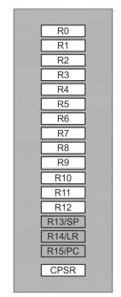
Register....contd
R15: Used as the program counter that points to the next instructions to be executed. In ARM state, all instructions are of 32-bits(four bytes).
User mode register set
Faculty of Computing and Informatics, JIT, Jimma University, Jimma, Oromia, Ethiopia Presented by Dr. Faiz Akram

Slide 32
GPIO
GPIO stand for General Purpose Input/Outputs, meaning that it's a module capable of receiving and transmitting signals. They work with digital signals but can be mixed to use the pins with other peripheral fonctions (ADC, SSI, UART, etc).
A GPIO port handles both incoming and outgoing digital signals. As an input port, it can be used to communicate to the CPU the ON/OFF signals received from switches, or the digital readings received from sensors.
The GPIO peripheral provides dedicated general-purpose pins that can be configured as either inputs or outputs. When configured as an output, you can write to an internal register to control the state driven on the output pin.
Purpose of GPIO pins:
A GPIO (general-purpose input/output) port handles both incoming and outgoing digital signals. As an input port, it can be used to communicate to the CPU the ON/OFF signals received from switches, or the digital readings received from sensors.
Faculty of Computing and Informatics, JIT, Jimma University, Jimma, Oromia, Ethiopia Presented by Dr. Faiz Akram

Slide 33
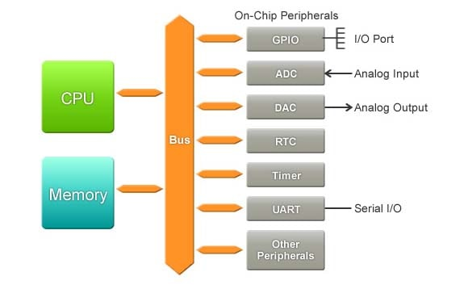
GPIO….contd
Peripheral: GPIO
Faculty of Computing and Informatics, JIT, Jimma University, Jimma, Oromia, Ethiopia Presented by Dr. Faiz Akram

Slide 34
ADC and DAC
Input and output in embedded systems:
Input devices/systems are providing data to the embedded system, output devices/systems are transmitting data from the embedded system.
I/O devices/systems can be connected to the embedded system wireless/wired way or placed directly on the board.
IO subsystem:
The I/O (input output) subsystem consists of the system bus, disk controllers, disks, tape drives, and other I/O devices. The I/O database application utilizes the Windows operating system I/O to read and write operations on disk.
Faculty of Computing and Informatics, JIT, Jimma University, Jimma, Oromia, Ethiopia Presented by Dr. Faiz Akram

Slide 35
ADC and DAC
ADC and DAC:
As its name implies, an analog-to-digital converter (ADC) takes an analog wave as an input and converts this wave to a digitally represented output form (Fig. A).
A digital-to-analog converter (DAC) essentially does the reverse, converting a digital representation into an analog form (Fig. B).
The Digital to Analogue Converser (DAC) is a device that converts a binary representation of a number to an actual analogue voltage on an external pin.
Faculty of Computing and Informatics, JIT, Jimma University, Jimma, Oromia, Ethiopia Presented by Dr. Faiz Akram

Slide 36
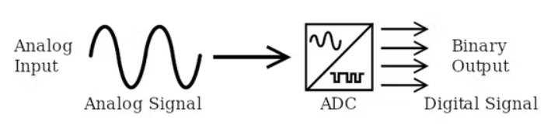
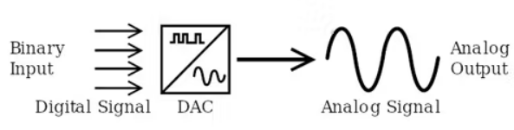
ADC and DAC….contd
Fig: A- Schematic shows basic ADC functionality
Fig: B- Schematic shows basic DAC functionality
Faculty of Computing and Informatics, JIT, Jimma University, Jimma, Oromia, Ethiopia Presented by Dr. Faiz Akram

Slide 37
Serial and Parallel Communication
Wired (UART, USART, SPI, I2C and Ethernet) at Physical-Data Link layer communication technologies
Serial and Parallel Communication
•Serial means one bit after another in successive time intervals over a
wire
•Parallel all bits in a word at the same times communicate at different
wires
Faculty of Computing and Informatics, JIT, Jimma University, Jimma, Oromia, Ethiopia Presented by Dr. Faiz Akram

Slide 38
Communication Technologies
Use of a Bus for communication
•Bus: A common set of signals connected to number of devices
•Each device is assigned distinct address and source device specifies a destination
address
•But at a given instance, only one pair of devices communicate over the bus
Two modes: Asynchronous and Synchronous communication
•Asynchronous means all bytes in a data frame may transmit with variable time-
interval spacing or phase difference
•Synchronous means all bytes in a frame transmit with equal time interval spacing or phase difference
Wired Communication Technologies
(i) Asynchronous serial communication, for example, UART interface
(ii) Synchronous serial communication devices, for example, SPI(serial peripheral
interface) used for short distance communication, and
(iii) Parallel input, output and input-output ports in devices.
Faculty of Computing and Informatics, JIT, Jimma University, Jimma, Oromia, Ethiopia Presented by Dr. Faiz Akram

Slide 39
Communication Technologies....contd
(Wired communication Examples)
•UART or USART
•I2C / I²C
•SPI
•Ethernet Protocol
•USB port, microUSB or USB 3.0 adapter
UART (Universal Asynchronous Receiver and Transmitter)
• Serial asynchronous communication (transmission) of 8 bits serially
• An additional bit appends between stop bit and last bit of the byte.
USART (Universal Synchronous/ Asynchronous Receiver and Transmitter)
•Two modes: Synchronous/Asynchronous
•Mode 1: Synchronous means all bytes in a frame transmit with equal time interval
spacing and a set of sync code bits between successive bytes;
•Mode 2: Asynchronous mode as UART
Faculty of Computing and Informatics, JIT, Jimma University, Jimma, Oromia, Ethiopia
Presented by Dr. Faiz Akram

Slide 40
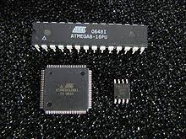
ATmega32 microcontroller Architecture
ATmega32 is a low power CMOS 8-bit microcontroller based on the AVR enhanced RISC architecture. Due to RISC, AVR can execute 1 million instructions per second if cycle frequency is 1MHz. Key Features: 32 x 8 general working purpose registers.
By executing powerful instructions in a single clock cycle, the ATmega32 achieves throughputs approaching 1 MIPS per MHz allowing the system designer to optimize power consumption versus processing speed.
Faculty of Computing and Informatics, JIT, Jimma University, Jimma, Oromia, Ethiopia
Presented by Dr. Faiz Akram

Slide 41
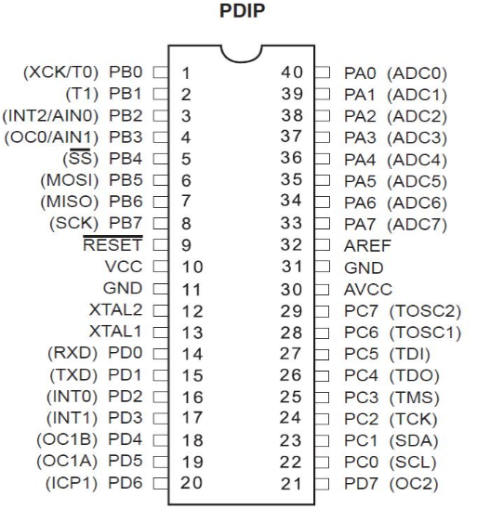
ATmega32 Microcontroller Pin Diagram
Faculty of Computing and Informatics, JIT, Jimma University, Jimma, Oromia, Ethiopia
Presented by Dr. Faiz Akram

Slide 42
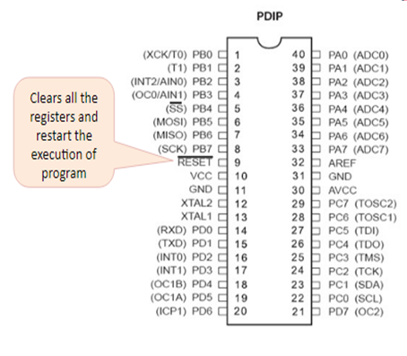
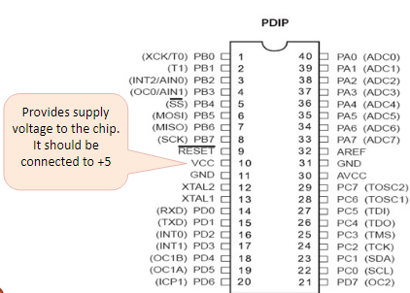
ATmega32 Microcontroller Pin Diagram….contd
Faculty of Computing and Informatics, JIT, Jimma University, Jimma, Oromia, Ethiopia
Presented by Dr. Faiz Akram

Slide 43
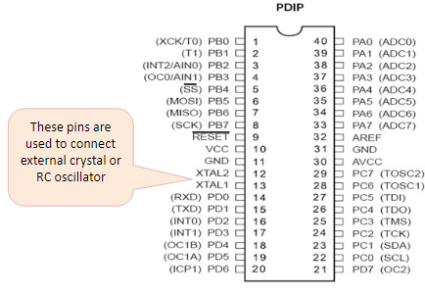
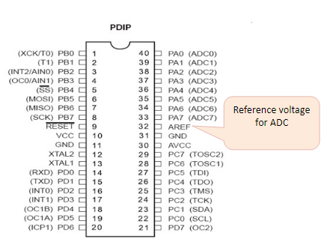
ATmega32 Microcontroller Pin Diagram….contd
Faculty of Computing and Informatics, JIT, Jimma University, Jimma, Oromia, Ethiopia
Presented by Dr. Faiz Akram

Slide 44
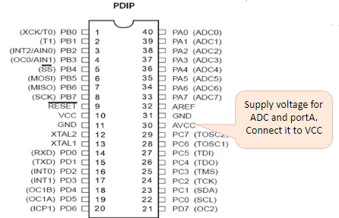
ATmega32 Microcontroller Pin Diagram….contd
Faculty of Computing and Informatics, JIT, Jimma University, Jimma, Oromia, Ethiopia
Presented by Dr. Faiz Akram

Slide 45
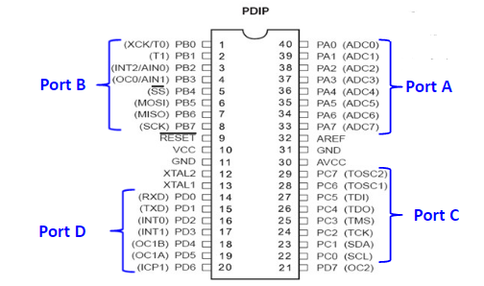
ATmega32 Microcontroller Pin Diagram….contd
Faculty of Computing and Informatics, JIT, Jimma University, Jimma, Oromia, Ethiopia
Presented by Dr. Faiz Akram

Slide 46
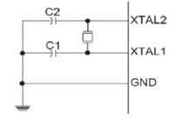
ATmega32 pin out &Description
VCC & GND – Digital supply voltage for ATmega32.Typical operating voltage are 2.7–5.5V. Should never exceed 6.0V.
XTAL1 & XTAL2–Connections to ceramic/crystal on-chip oscillator for generating internal clocks. Crystal connection as below where typical values for C1, C2 are 22pF.
Max crystal freq. is 16MHz.
Faculty of Computing and Informatics, JIT, Jimma University, Jimma, Oromia, Ethiopia
Presented by Dr. Faiz Akram

Slide 47
ATmega32 Microcontroller Pin Descriptions
Port A (PA7-PA0): Port A serves as analog inputs for A/D converter. It also acts as an 8-bit bidirectional I/O port if the A/D converter is not used internally.
Port B (PB7-PB0) and Port D (PD7-PD0): These ports are 8-bit bidirectional I/O ports. Their output buffers have symmetrical drive characteristics with high source and sink capability. As inputs, these are pulled low if the pull-up resistors are used. It also provides various special functional features of the ATmega32.
Port C (PC7-PC0): Port C is an 8-bit bidirectional I/O port. If the Joint Test Action Group (JTAG) interface is enabled, the pull-up resistors on pins PC2 (TCK), PC3 (TMS), and PC5 (TDI) will be activated.
Faculty of Computing and Informatics, JIT, Jimma University, Jimma, Oromia, Ethiopia
Presented by Dr. Faiz Akram

Slide 48
ATmega32 Microcontroller Pin Descriptions….contd
Vcc: Digital voltage supply
GND: Ground
RESET: It is a RESET pin which is utilized to set the microcontroller ATmega32 to its primary value. During the beginning of an application the RESET pin is to be set elevated for two machine rotations.
XTAL1: It is an input for the inverting oscillator amplifier and input to an internal clock operating circuit.
XTAL2: It is an output from an inverting oscillator amplifier.
AVcc: It is a supply voltage pin for A/D converter and Port A. It must be connected with Vcc.
AREF: AREF is an analog signal reference pin for the analog to digital converter.
Faculty of Computing and Informatics, JIT, Jimma University, Jimma, Oromia, Ethiopia
Presented by Dr. Faiz Akram

Slide 49
ATmega32 Communication Options
ATmega32 has three data transfer modules embedded in it. They are
Two Wire Interface
USART
Serial Peripheral Interface
Faculty of Computing and Informatics, JIT, Jimma University, Jimma, Oromia, Ethiopia
Presented by Dr. Faiz Akram

Slide 50
Timers
Timers:
Real time clock-system clock, on each tick SysClkIntr interrupts
Based on each SysClkIntr interrupts─ there are number of OS timer
functions
Timer are used to message the elapsed time of events for instance ,
the kernel has to keep track of different times
The following functions calls are provided to manage the timer
Get time
Set time
Time delay( in system clock)
Time delay( in sec.)
Reset timer
Faculty of Computing and Informatics, JIT, Jimma University, Jimma, Oromia, Ethiopia
Presented by Dr. Faiz Akram

Slide 51
THANK YOU
Faculty of Computing and Informatics, JIT, Jimma University, Jimma, Oromia, Ethiopia

